Slide 1



Improve PowerShell Code Efficiency with
.NET Runspaces

Slide 2

Who Am I
Everwise Credit Union
Systems Administrator
App Xtender/Enhancer
SMA OpCon
PowerShell

Slide 3




Everwise Credit Union
X
GitHub
LinkedIn

Slide 4

Documentation for Presentation (GitHub)

Slide 5
AGENDA
Asynchronous Processing
.NET in PowerShell
Runspaces
Runspace Pools
Demo

Slide 6


Why Asynchronous Processing
…………………..........................
Faster……………………………………………………..

Slide 7
Synchronous
Vs
Asynchronous
Notes:
Synchronous – sequentially, one after another
Asynchronous – Simultaneous, don’t wait for another process to complete.

Slide 8
Ways to create asynchronous Processes
Jobs
Reacting to Events
.Net Runspaces
ForEach-Object with –Parallel (PS 7)
Start-ThreadJob (PS 7)

Slide 9
.NET in PowerShell
Notes:
.NET Runspace Advantages
Flexibility
Efficient
.NET Runspace Disadvantages
Complex

Slide 10
The Following .NET Topics Covered:
Namespaces
Types
Classes
Assemblies
Notes:
Assemblies – A collection of types and any other supporting resources. An assembly may be static or dynamic.
Types – Describe the functionality of an object.
Classes – Instruction on how an instance of object behaves. Once a class has been compiled, it becomes a type.
Namespaces – Organizes types into groupings with related functionality.

Slide 11
.NET Namespaces
Organizes types into a hierarchy, grouping types
With related functionality
e.g. [Namespace]
Notes:
List NameSpaces
[System.AppDomain]::CurrentDomain.GetAssemblies().GetTypes() | Select {$_.namespace} -Unique | Out-Host –paging
https://learn.microsoft.com/en-us/dotnet/api/?view=netframework-4.8&preserve-view=true

Slide 12
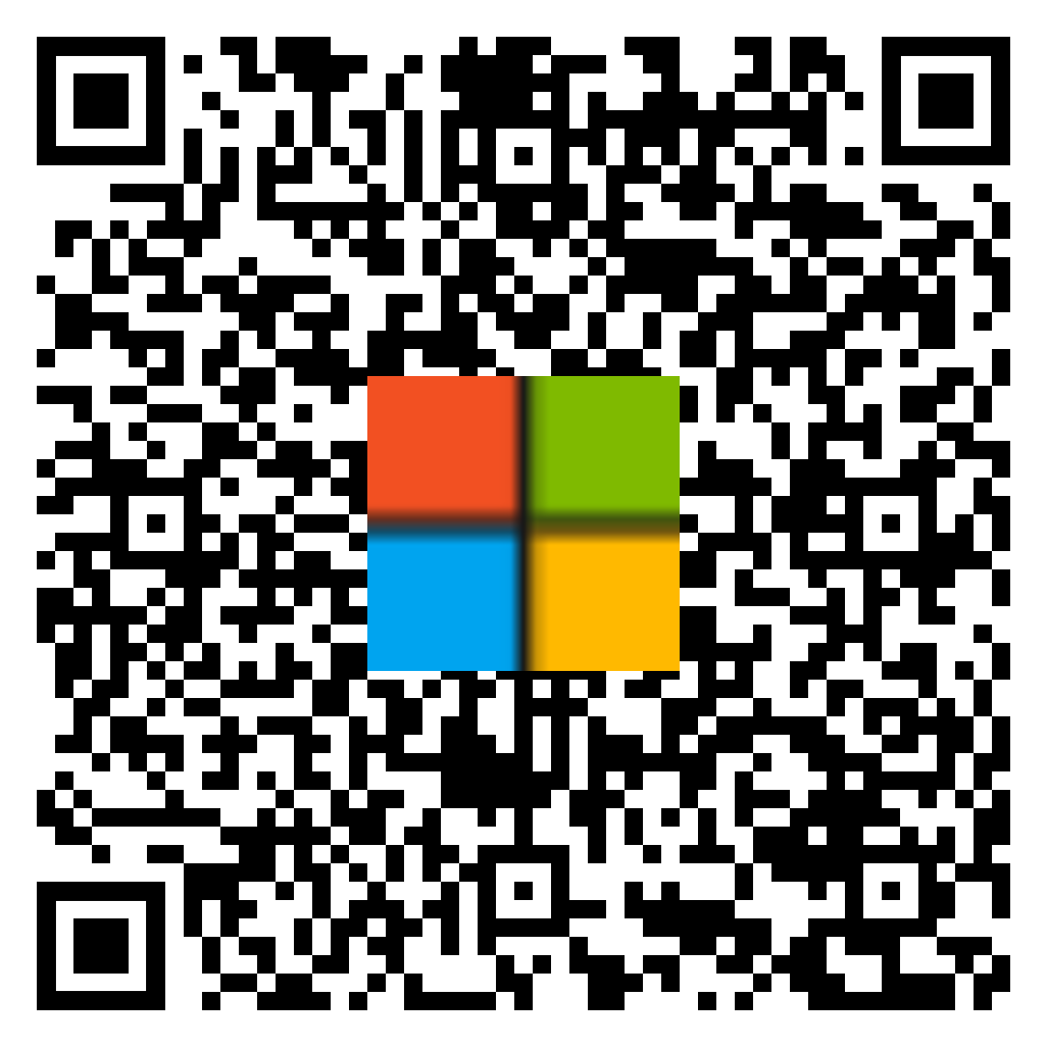
List .NET Namespaces
[System.AppDomain]::CurrentDomain.GetAssemblies().GetTypes() | Select Namespace -Unique
.NET API Browser

Slide 13
.NET Types
Used to represent the functionality of an object
e.g. [Namespace.TypeName]
Notes:
Get-process | gm | more
[Systems.Diagnostics.Process]
[Systems.Diagnostics.Process]::GetProcesses()
https://learn.microsoft.com/en-us/dotnet/api/?view=netframework-4.8&preserve-view=true
[System.Diagnostics.Process] | get-member –static
[System.Diagnostics.Process]::getprocess()

Slide 14
Classes
A set of instructions used to create instances of an object at runtime.
e.g. [Namespace.TypeName]::ClassMethod()
Notes:
Get-process | gm | more
[Systems.Diagnostics.Process]
[Systems.Diagnostics.Process]::GetProcesses()

Slide 15
List Classes of Namespaces
[AppDomain]::CurrentDomain.GetAssemblies().GetTypes() | Where-Object {$_.NameSpace -eq 'System.IO'}
.NET API Browser

Slide 16
.NET Assemblies
A collection of Types
e.g. [Namespace.TypeName].Assembly.location
Notes:
[System.AppDomain]::CurrentDomain.GetAssemblies()
Install-Module ClassExplorer
Get-Assembly
[System.Windows.Forms.Checkbox]
Add-Type –AssemblyName System.Windows.Forms
Using namespace System.Windows.Forms
[checkbox]
[Checkbox] | gm –static
[System.Management.Automation.PowerShell].Assembly
$checkBox = [System.Windows.Forms.checkbox]::new()
$form = [System.Windows.Forms.Form]::new()
$form.Text = 'PSConf 2024’
$checkBox.Text = 'Text Box’
$form.Controls.Add($checkbox)
$form.ShowDialog()

Slide 17
.NET Demo
Notes:
.NET Runspace Advantages
Flexibility
Efficient
.NET Runspace Disadvantages
Complex

Slide 18
Create a .NET RunSpace

Slide 19
Create a PowerShell Runspace Instance
[System.Management.Automation.PowerShell]
[PowerShell]
$psInstance = [PowerShell]::Create()
Notes:
[System.Management.Automation.PowerShell] type can be used as just [PowerShell]

Slide 20
Methods to be used with ‘PowerShell’ Type
AddCommand(‘Command’)
AddParameter(‘ParameterName’,’Parameter’)
AddStatement()
AddScript({Script})

Slide 21
Methods to be used with ‘PowerShell’ Type
Invoke()
BeginInvoke()

Slide 22
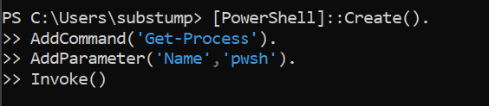
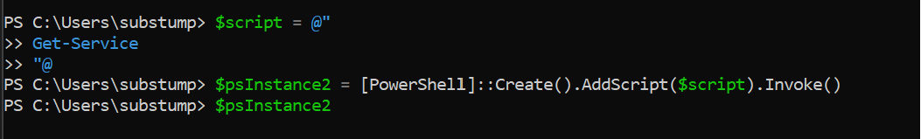
Example Runspace Creation

Slide 23
Create a .NET Runspace Pool

Slide 24
Create a PowerShell Runspace Pool Instance
$rsp = [RunspaceFactory]::CreateRunspacePool(1,5)
$rsp.Open()
$rs.RunspacePool = $rsp

Slide 25
PowerShell Runspace – Deallocate Objects
$jb.Instance | Foreach-Object Dispose
$rsp.Dispose()
[GC]::Collect()

Slide 26
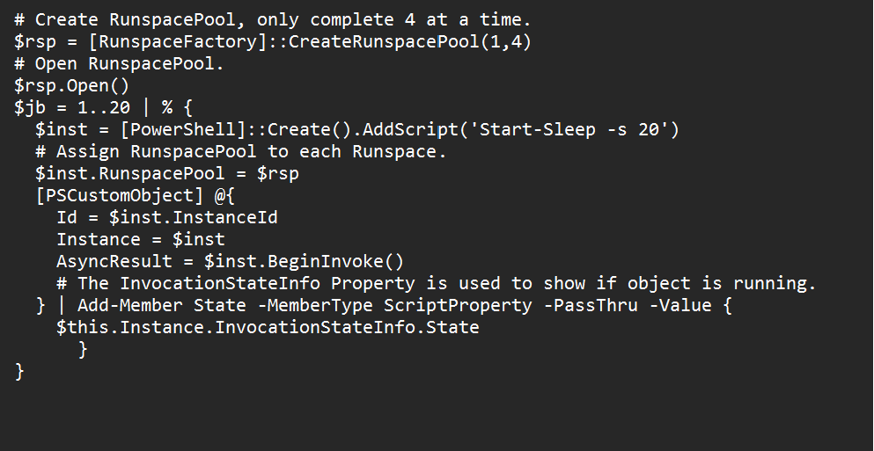
Example Runspace Pool

Slide 27
.NET Runspace Demo
Notes:
(Get-Command Test-RunSpacePool).definition
$jb = Test-RunSpacePool
$jb

Slide 28
.NET Sample Code

Slide 29
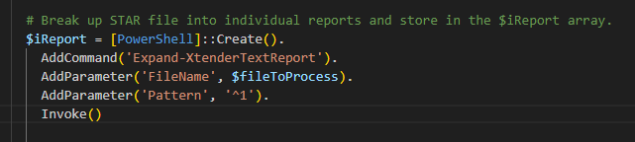
.NET Expand Report

Slide 30
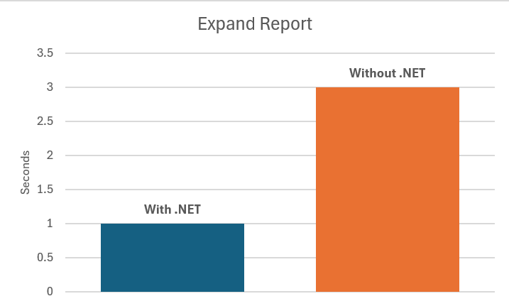
Time to Expand Reports
1000 Reports

Slide 31
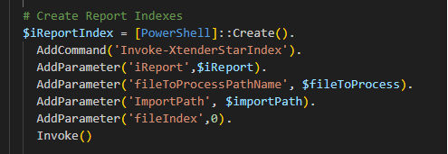
.NET Index Report

Slide 32
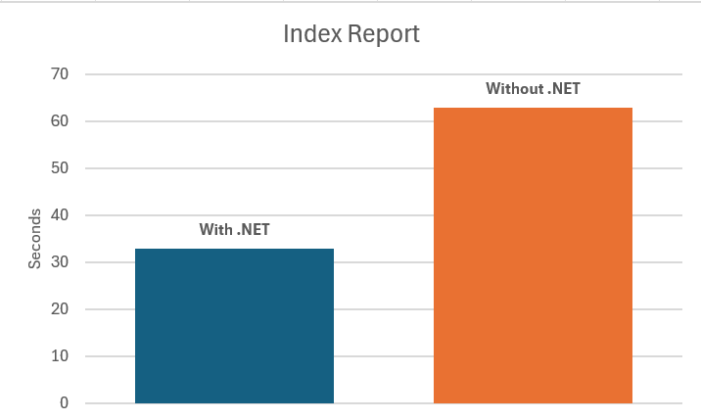
Time to Index Reports
11252 Reports

Slide 33
Final Demo

Slide 34
Call To Action
Good Programming Practices
Consider .NET Runspace to isolate your script

Slide 35
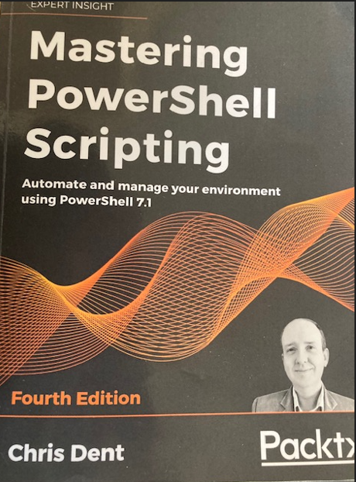
Resource
Mastering PowerShell Scripting
Fourth Edition
By Chris Dent

Slide 36


Slide 37

THANK YOU
Please review this session
Documentation
LinkedIn

